Slide 1
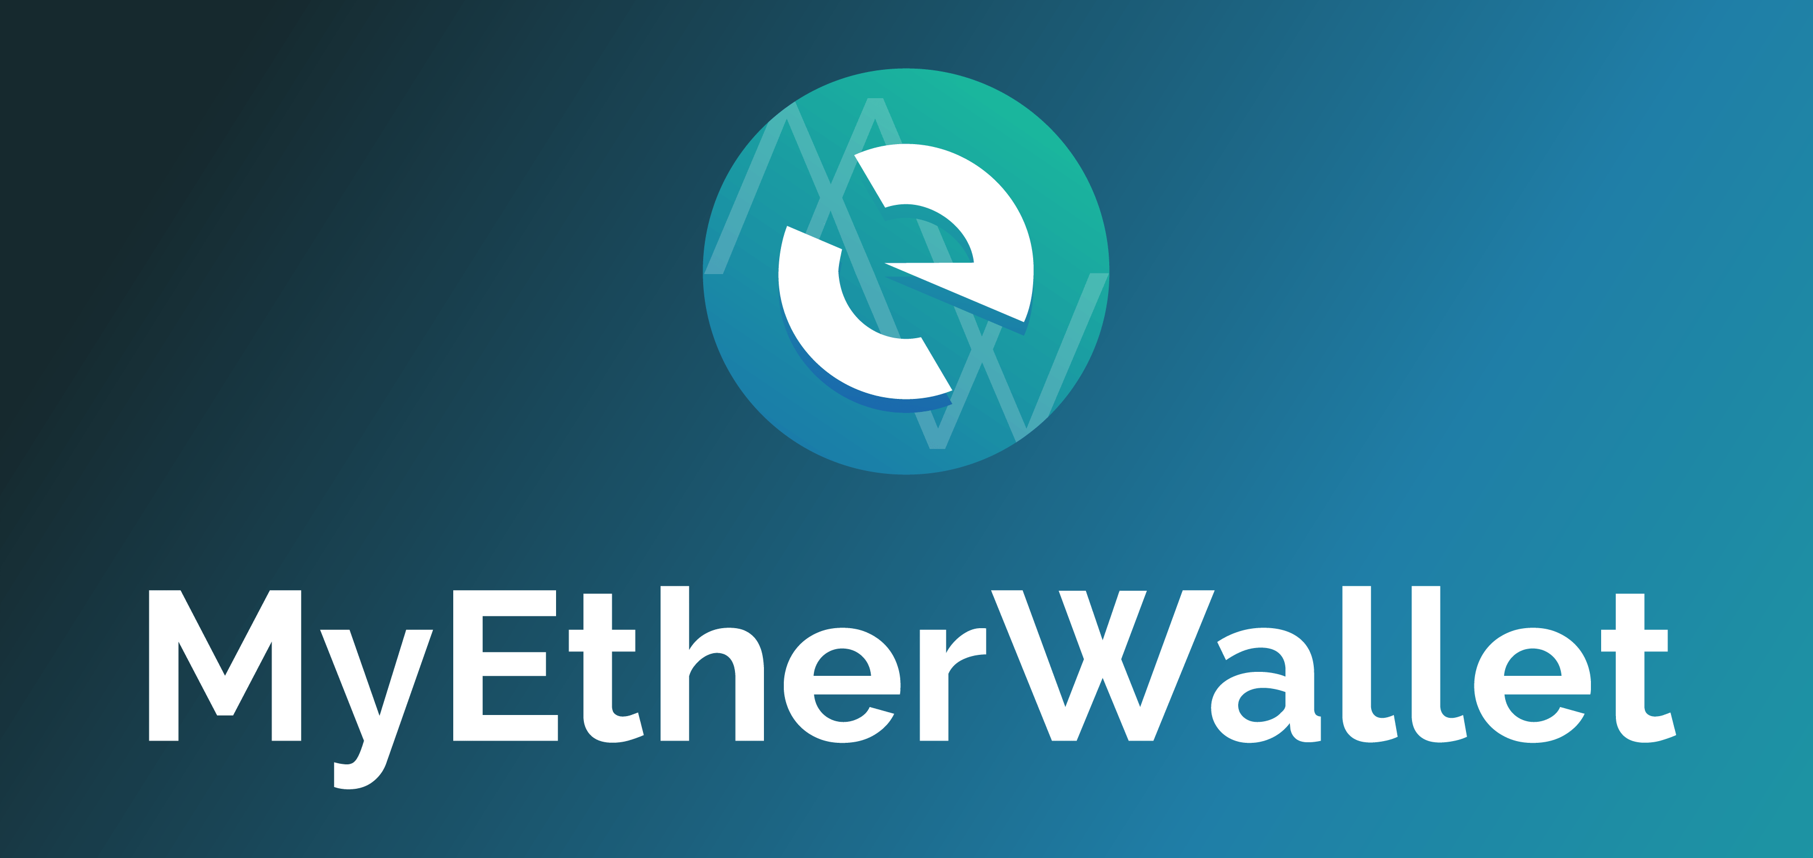

A free, open-source, client-side interface for generating Ethereum wallets & more. Interact with the Ethereum blockchain easily & securely.
Country/Choose Language
OPEN WALLET
CREATE NEW WALLET
I’m New – Discover More about….(recommended for first timers)

Slide 2

Thank you for visiting MyEtherWallet!
We will guide you through the Generate a Wallet Process and even assist you with a test transaction, but for now…
…let’s get you acquainted with how MyEtherWallet works.
I’m sure you have lots of questions like…”What is a blockchain”
You can explore that and more later in our Knowledge Base/Help Center
Next
FROM “I’M New”

Slide 3


So more than likely, you are here to generate a wallet so that you can send/receive cryptocurrency.
Ethereum is similar to Bitcoin, but not exactly. Learn more about it after this overview in our Knowledge Base/Help Center
< Prev Next>
FROM “I’M New”

Slide 4
MyEtherWallet provides you with an easy-to-use interface that safely and securely interacts with the Ethereum blockchain.
< Prev Next>
FROM “I’M New”

Slide 5
Now let’s take a quick look at something you are familiar with, the traditional bank.
62% of the worlds Adult Population has a bank account.
93% of American Households have a bank account.
< Prev Next>
FROM “I’M New”

Slide 6

Traditional Currency/Banking Systems require a centralized point, in this case a traditional bank.
Traditional Bank
< Prev Next>
FROM “I’M New”

Slide 7




The “centralized” bank controls your personal/confidential information, account passwords and login information and ultimately, they partially control your money…with high fees to manage your account.
+
Traditional Bank
< Prev Next>
FROM “I’M New”

Slide 8
Traditional banks are non-transparent and are vulnerable either through bank negligence or criminal activity including
Robbery/Internal Theft – Bank Servers Being Hacked of Information
Traditional Bank
< Prev Next>
FROM “I’M New”

Slide 9

Traditional banks are non-transparent and are vulnerable either through bank negligence or criminal activity including
Robbery/Internal Theft – Bank Servers Being Hacked of Information
Traditional Bank
< Prev Next>
FROM “I’M New”

Slide 10
MyEtherWallet is a CLIENT-SIDE wallet. This means that YOU the user, are in control.
< Prev Next>
FROM “I’M New”

Slide 11
You are responsible for your sensitive information such as your private key and password.
Private Key
Password
< Prev Next>
FROM “I’M New”

Slide 12
Losing your private key or password or failing to avoid phishing attacks will compromise your wallet.
We have great tips on how to secure your information including external hard wallets
Private Key
Password
< Prev Next>
FROM “I’M New”

Slide 13
By integrating Blockchain technology and creating a Decentralized environment,
MyEtherWallet allows you to take advantage of lower fees and most importantly,
being in full control of your private keys, passwords and your hard earned money.
Basically YOU become the bank.
+
You
< Prev Next>
FROM “I’M New”

Slide 14




What happens when you generate a wallet?
A Password is submitted by you the user and MyEtherWallet generates a Private Key/Keystore File
You will need BOTH the Password and Private Key or File to access your wallet from your computer, or node.
You
< Prev Next>
FROM “I’M New”

Slide 15
Once your wallet is generated you can use our interface to:
access your wallet, view balances, swap tokens and send/receive cryptocurreny through a third party exchange.
You
< Prev Next>
FROM “I’M New”

Slide 16

In order to ensure your security & privacy, no sensitive data is ever saved, stored, or transmitted when you use MyEtherWallet. We only have access to the information that is publicly available on the blockchain.
This means MyEtherWallet CANNOT:
Recover your private key / Access you account / Recover or reset your password / Reverse or cancel transactions
Recover your account / Send your ETH or Tokens from one address to another
You
< Prev Next>
FROM “I’M New”

Slide 17
The user is fully responsible for their account. This means ensuring these funds are stored securely (e.g. a hacker cannot get your key), backed up in an external location (standard operating procedure for any bank or data center), and that you protect your funds moving forward (e.g. being aware & careful of where you enter your private key)
PHISHING
ATTACKS
You
< Prev Next>
FROM “I’M New”

Slide 18

As long as you are capable of securing your sensitive information and are smart about avoiding phishing attacks, your experience with MyEtherWallet and Blockchain technology will be a happy one.
You
< Prev Next>
FROM “I’M New”

Slide 19
Thank you for your going through our Overview!!
if you are ready to generate a new wallet, click below.
If you are still unsure, visit our KB/Help Center for additional information or contact a third party to handle your transactions.
.
< Prev
I’m ready!
Let’s generate My(NEW)EtherWallet
Unsure, Take me to KB/HC/Support

